Slide 1
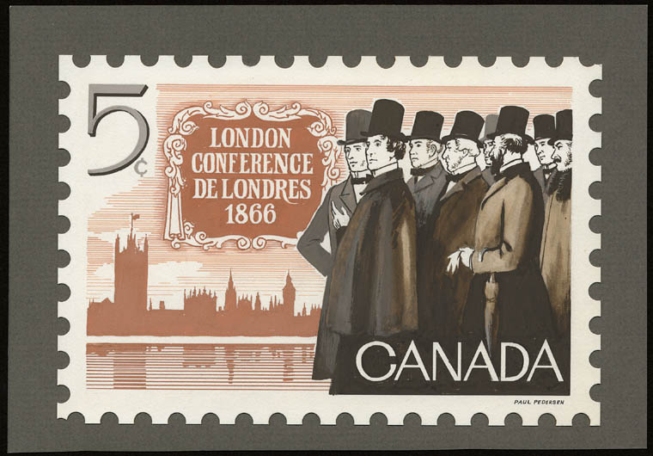
Welcome to The London Conference

Slide 2
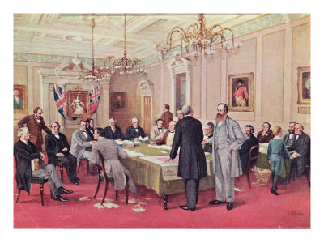
But first, how did we get here?

Slide 3
Charlottetown Conference
DATE: September 1-9 1864
LOCATION: Charlottetown, P.E.I.
KEY PLAYERS: Martimes and Canadas
LEFT OUT: British Columbia, Newfoundland, Aboriginals and Marginalized peoples
KEY DECISIONS: Reached a consensus to create a larger union of all five provinces, and agreed to meet in Quebec in one month to work out the terms.

Slide 4
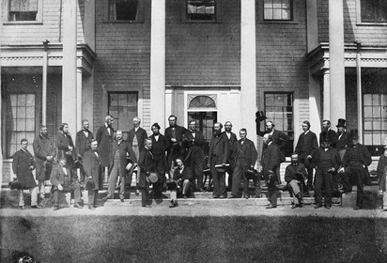
Conversations with our Classroom Delegates:
"We feel outraged that this was our land originally and we don't get a say in any thing." - The Aboriginals
" We feel good about the outcome of the Charlottetown Conference because most of the Maritime colonies decided to unite with the Canadas." - Canada East
"We feel a little upset because the British Columbians didn't get invited and a lot of the really important decisions were made without putting us into consideration." - B.C.

Slide 5
Conversations with our Classroom Delegates:
"My colony would rather the other colonies drop the topic of joining together, because there are no benefits to it. For example taxes may be raised, and it will do damage to our economy." - Newfoundland
" We feel that the outcome of the conference were good because we decided to unite with Canada East and Canada West and meet in Quebec to work out the terms which was better for us than if we didn't unite." - Maritimes
"My group was not invited to any of the conferences. We didn't know the meetings were happening." - Marginalized
"My colony feels great about the outcome." - Canada West

Slide 6
Quebec Conference
DATE: October 1864
LOCATION: Quebec City
KEY PLAYERS: Martimes, Canadas, and Newfoundland.
LEFT OUT: British Columbia, Aboriginals and Marginalized peoples
KEY DECISIONS:
1) Sir John A. MacDonald's 72 Resolutions
• Senate and House of Commons
• Federal and provincial governments
• Ontario and Quebec
2) Reactions in the Atlantic Colonies
The Maritimes were largely opposed to the 72 Resolutions. Prince Edward Island and Newfoundland rejected Confederation.

Slide 7
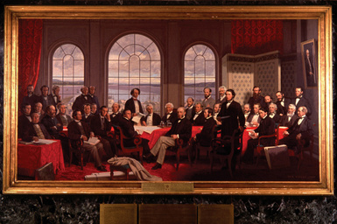
Conversations with our Classroom Delegates:
"My group is overjoyed because maybe the woman and the ex-slaves will be treated equally." - Marginalized
"We were not very excited about the idea at first because if the colonies joined they would spread into our land and we have a good trade system going and we don't want that to change." - Aboriginals
"We are happy because we hope to have the first prime minister and we were the "top dogs" at the conference." - Canada West

Slide 8
Conversations with our Classroom Delegates:
"Most people thought that because we are such small colonies we would have very little impact on any decisions made from there on out. P.E.I. was worried that we wouldn't receive as many seats as other larger colonies. Some of us thought if just Nova Scotia, P.E. I., and New Brunswick formed a union we would be better off. We could easily support ourselves." - Maritimes
"We are a little upset, interested and have a little bit of excitement. We are upset because for some of the confederation meetings we were not invited/included, and some of the choices that were made were not what we would have chosen to do. We are interested because we want to know what some of the big final decisions were, which we may or may not be included in. We are excited because there are new sets of rules and people that rule over others and we want to see how everything will play out." - B.C.

Slide 9
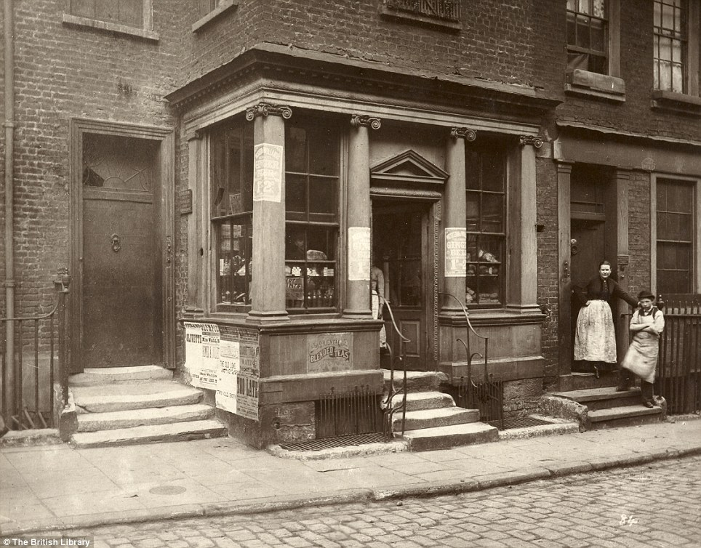
So let's get back to London…

Slide 10
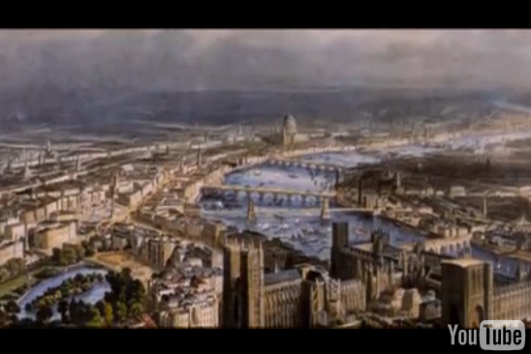
Setting the Scene...
http://www.tubechop.com/watch/1686066

Slide 11
True or False Conversations
With your group, discuss the questions and (upon the signal) hold up your "true" or "false" sign.
1. The delegates were upset they had to go in London; they felt the whole thing was too expensive.
2. John A. MacDonald once again proved his value as a leader.
3. This was a simple case of quickly approving the Quebec deal.
4. Only 4 resolutions in total were changed.
5. The delegates were on careful guard to make sure the Quebec deal was held in place with few to no changes.

Slide 12
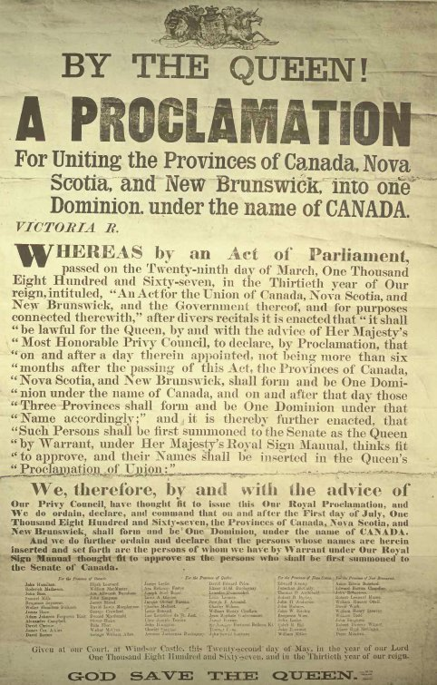

Slide 13
Some final items before returning home...
After the Conference, Canada became Britain's first "self- governing Dominion"
Canada retained the Monarchy, but only as a symbol and its place in the British Empire
Britain still maintained control over our foreign policy until 1923
Canada was given control over internal affairs, although until 1982 (just over 20 years ago!), the British government had final power in making changes to the Canadian Consititution
Don't forget to add these ideas to your group's graphic organizer!

Slide 14
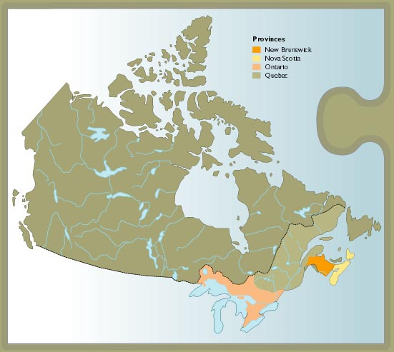
The Dominion of Canada

